Slide 1

Job Shop Sequencing Problem
Group Member
  Muhammad ali raza 21-ie-21

Slide 2

Table Of Contents
Our Table of Contents mainly Comprises of following points which will be described further in a prescribe way:
Introduction
Objective
Overview
Calculation
Conclusion

Slide 3

Introduction
Our Introduction Mainly Comprises of following Points:
a) t is desired to fabricate a prototype of the following production facilities which can process jobs according to the sequences generated by different heuristics in real time.
b) Job shop

Slide 4

Objective
This project aims to improve job sequencing in manufacturing through advanced computational methods. By minimizing makespan, it enhances resource use and production efficiency, aligning with Planning and Scheduling principles. Through optimization, it addresses key challenges in production planning, aiming for operational excellence in manufacturing.

Slide 5
Overview
So we have taken the Job Shop data Set from Kohinoor Textile Company Pvt Ltd in the form of Lot, Operation, Machine, Process Time, Lot Size 1,2 and 3 respectively. We have analyzed that data set on Python Programming Language on Colab and analyzed the result through it.
We have then did the coding on Colab and Computed the results through it.
The results we computed are in the form of charts, Visual Representation and data.
So we can understand them further.

Slide 6
Calculation
After taking the dataset on the Excel we have coded that data set in form of Python Code on Colab and it was helpful in computing the Results.
The results, data and Calculations are demonstrated in the form Colab Code and their further Computations:
Colab Python Code
Output Result Of that code
Graphical Representations

Slide 7

1) Colab Python Code

Slide 8
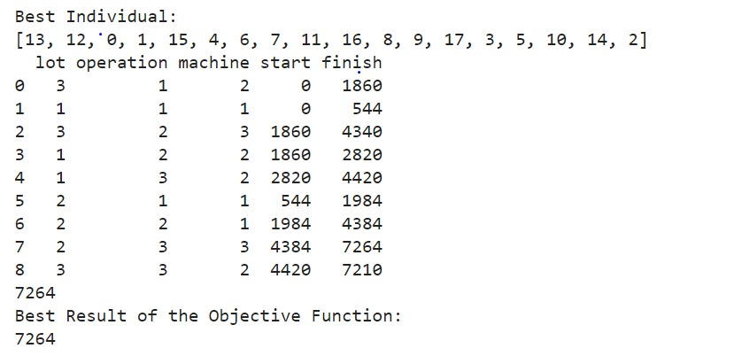
2) Output Result of that Code

Slide 9
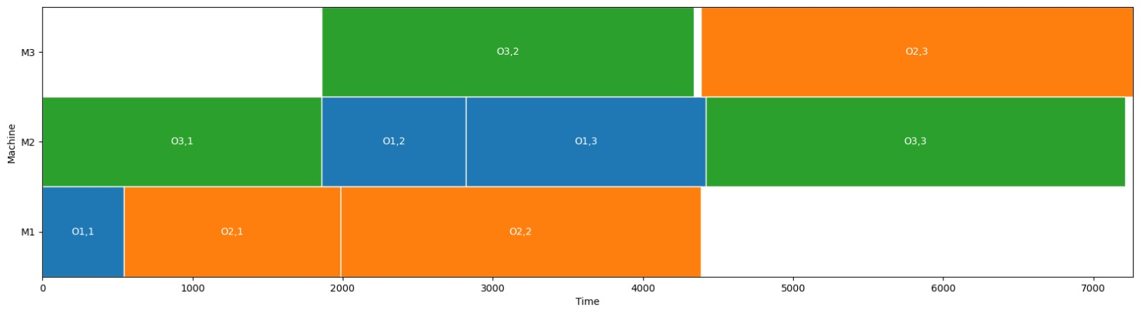
3) Graphical Representation

Slide 10
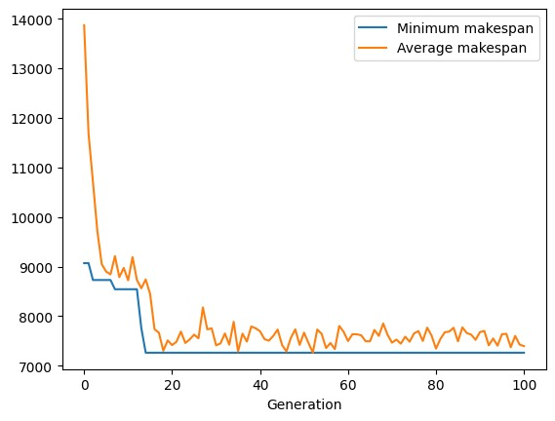
Continued…

Slide 11
Continued…
The provided results showcase the performance of the optimization process carried out by the Genetic Algorithm (GA) over multiple generations. Here's a breakdown of the key information presented:
Generation (gen): Indicates the generation number during the evolutionary process.
Number of evaluations (nevals): Represents the number of individuals evaluated in the current generation.
Average makespan (avg): Denotes the average makespan across all individuals in the population for the respective generation. The makespan represents the total time required to complete all jobs in the scheduling sequence.
Standard deviation (std): Reflects the variability or spread of makespan values within the population for the given generation.
Minimum makespan (min): Represents the best (lowest) makespan achieved by an individual in the population for the respective generation.
Maximum makespan (max): Indicates the worst (highest) makespan observed among all individuals in the population for the given generation.

Slide 12

Conclusion
The results provide insights into the progress of the optimization process over multiple generations. As the algorithm evolves, it aims to minimize the makespan, thereby improving the efficiency of job sequencing in the manufacturing environment. The best individual identified by the algorithm, along with its corresponding schedule details, is also provided, demonstrating the optimal sequencing achieved. Additionally, the best result of the objective function, which corresponds to the minimum makespan attained, confirms the effectiveness of the optimization approach in enhancing production scheduling.

Slide 13

THANKYOU

